Slide 1
At: ………………………………………………………School
Notes:
{Add your school name to the slide}
Introduce the project to everyone as a whole school project that culminates in an exciting nature walk and celebration lunch for them and their parents / carers.

Slide 2
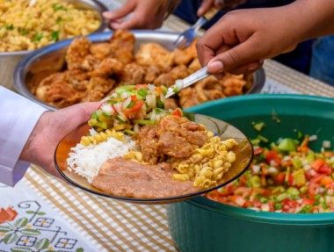
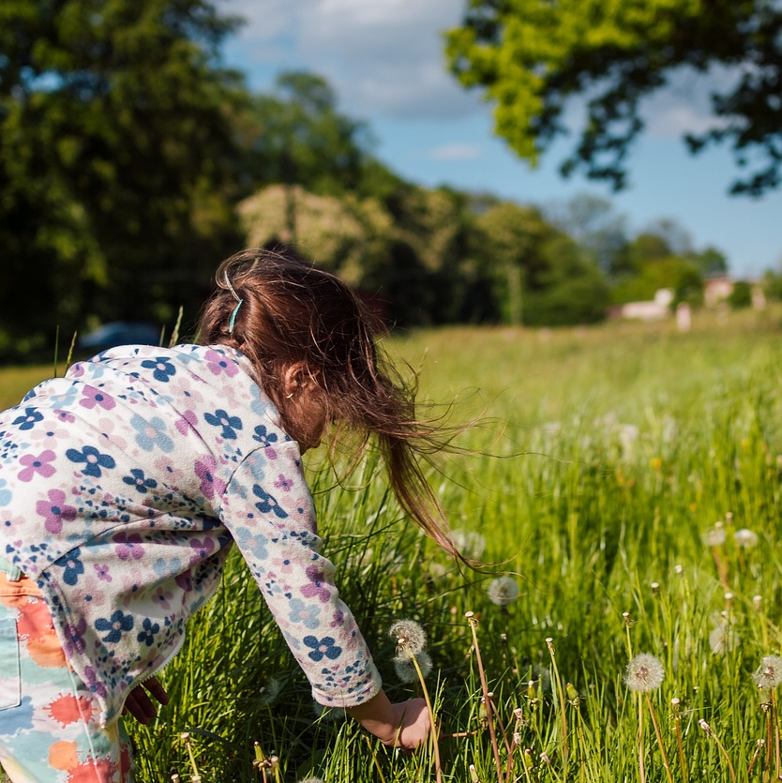
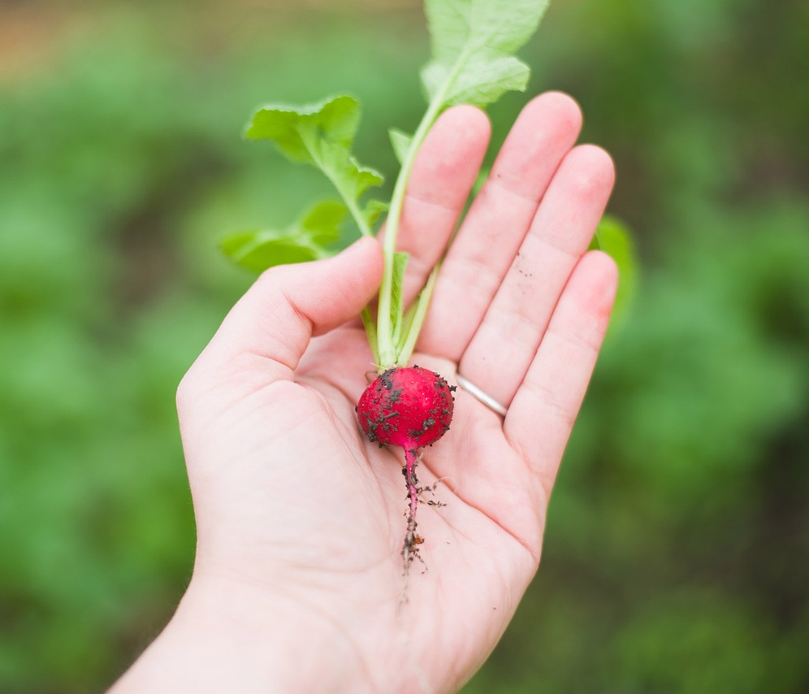
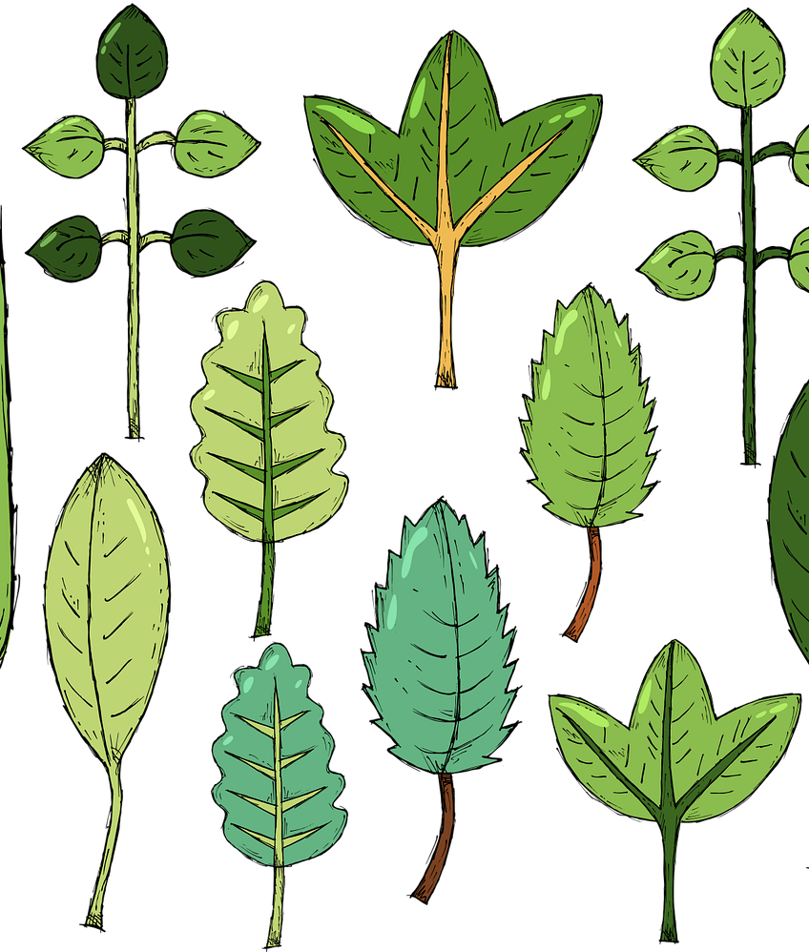
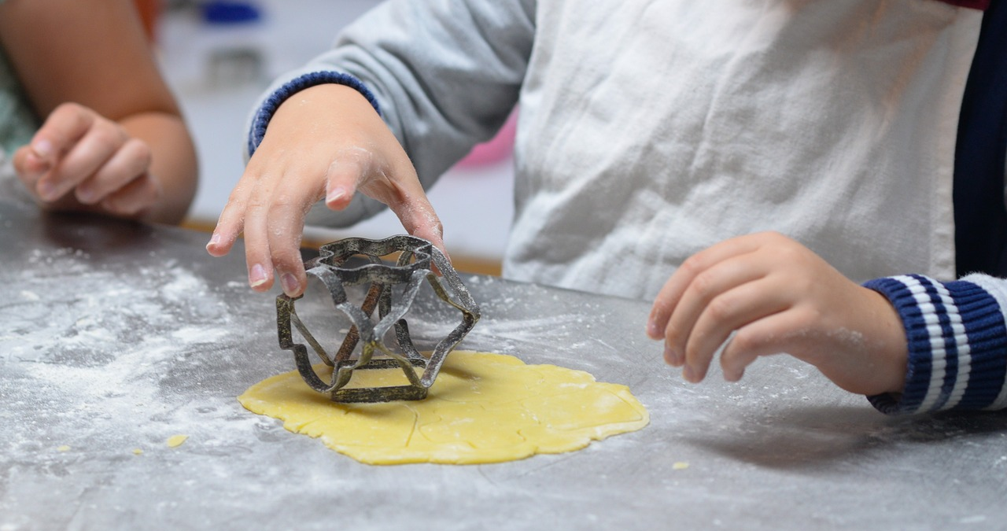
Autumn:
Nature Walk
and
Celebration Lunch
Notes:
Ask the children to look at the photos and suggest what the project will be about.
Share that they will be learning about farming, nature, growing and cooking, and bringing that knowledge and those skills together to put on a food event.
Also share that the project will support the school in achieving our Food for Life Bronze Award – which supports us in learning about the farming of, growing and cooking good food.

Slide 3
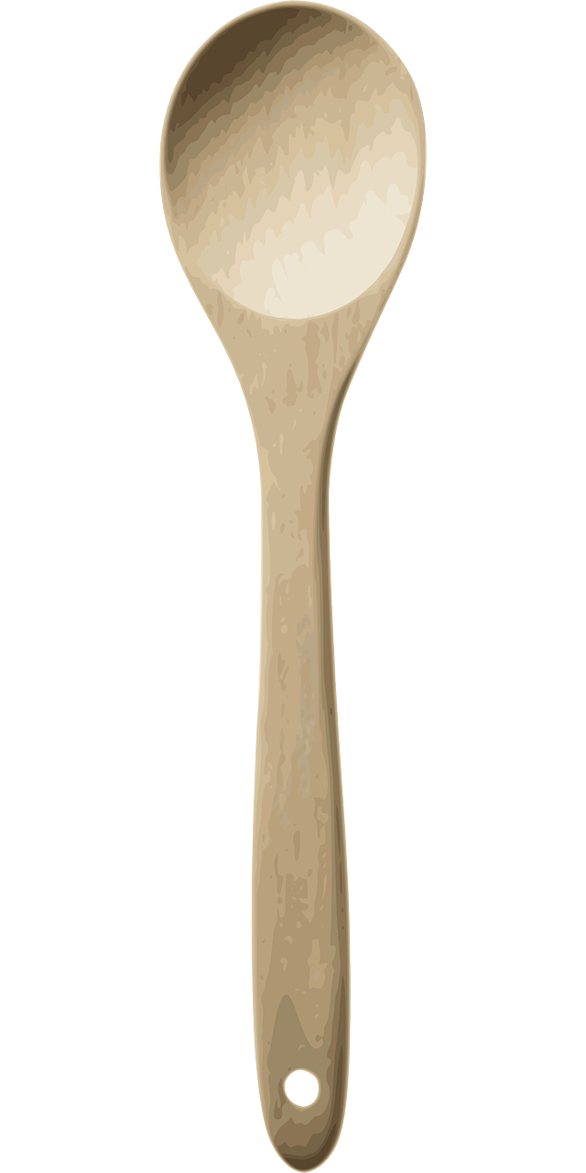
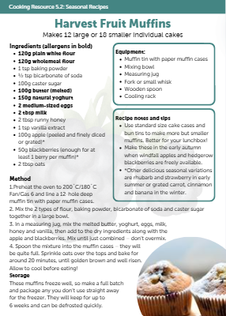
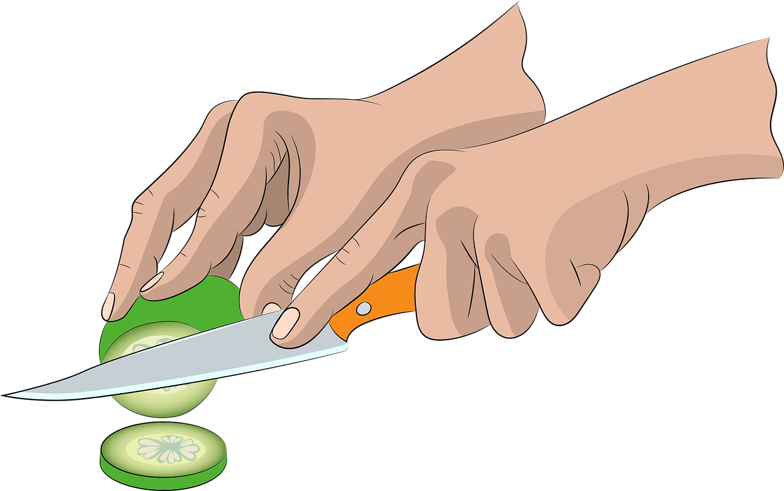
Timeline:
Learning
Planning
Growing
Cooking
Celebrating!
Notes:
Share the main sections of the project – the children will begin by learning about farming (how food is produced), nature and their school grounds before planning what they can grow and cook to host their celebration lunch for their families, and what fun activities they can prepare.

Slide 4
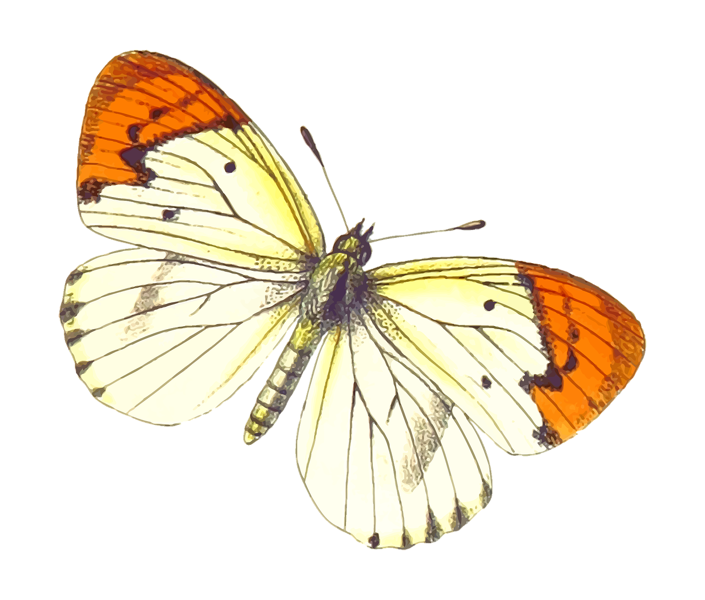
Growing
What food is grown near where you live?
Learning
Farms
Where does our food come from?
Health & well-being
Nature
How can our outdoor space at school help wildlife and the climate?
How can we be
closer to nature?
Notes:
Learning:
This part of the project, children will learn about farming and nature, and explore what plants and animals live in their school grounds.
Let’s find out what food grows near our school and our homes, what wildlife lives in our school grounds and why it is important, and why good food and being close to nature is good for our physical and mental health.

Slide 5
Growing
Planning
What can we grow to eat for celebration lunch?
What ingredients are in season?
Cooking
Nature walk
Celebration
lunch!
What recipes shall we make?
What exciting things could we do on a nature walk?
Who shall we invite?
Notes:
Planning:
After our learning, it will be time for us to get planning. We’ll need to set a date for our event and then work towards it! We’ll need to decide what recipes we would like to prepare and what we can grow to use in these recipes.
We’ll also have to plan our celebration menu, get our invitations ready to send to our parents and carers, and think of what fun activities we will do with them on the day. There will be lots to do, so we will all need to help!

Slide 6
In our school grounds?
What ingredients can we grow for our celebration lunch?
Where can we grow?
Growing
On the windowsill?
Linking to recipes
What can we grow?
What is in season?
Herbs?
Quick-growing crops?
Spring : Summer : Autumn : Winter
Notes:
Growing:
We will have to see what ingredients we can grow for our recipes in the time that we have before our event. We will also need to decide what areas around the school we could use for growing – some plants might grow best on our windowsills, others we might be able to plant outdoors in our growing area / bags / containers.
We will also need to decide which classes grow which crops!

Slide 7
in season
Ingredients
School kitchen
Cooking
What have we grown?
fresh
How can the school kitchen help with our event?
Recipes
Cooking
skills
What recipes shall we make?
Notes:
Cooking:
When it’s time for cooking, we can use the recipes we have chosen and ingredients we have grown to make some delicious food for our parents and carers to come in and share with us.
We also mustn’t forget about our school cooks – how might they be able to help us with the food for our event? Perhaps they can make some of the recipes we have chosen for the day.

Slide 8
Celebrating!
Let’s show off
our learning and skills!
Let’s work towards our
Food for Life
Award!
Nature walk
Celebration
Lunch
Let’s do some fun activities together!
Let’s share our delicious food!
Notes:
Celebrating:
When our celebration lunch day arrives, we’ll be able to bring together all of our learning and skills to create a great event and share our delicious food.
We can do some fun activities to encourage our parents to learn about nature and good food, as we will have done. And we will also be closer to achieving our Food for Life Bronze Award!

Slide 9
Which class
will lead on
the project?
When?
Autumn:
Nature Walk
and
Celebration Lunch
Questions
Who shall we invite?
Who decides on
the recipes we make?

