Slide 1
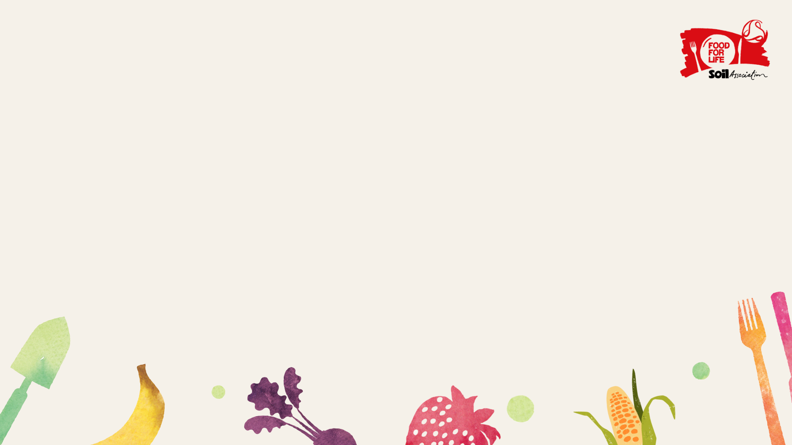
Food for Life
Healthy and Sustainable food
Notes:
1. Welcome the children and introduce yourself and Food for Life.

Slide 2
Put your hand up if you have ever…
Had a school dinner?
Grown a fruit or vegetable?
Been to a farm?
Helped with cooking at home?
Made a new friend at the dinner table?
Tried new food?
Notes:
2. Encourage the children to become engaged as soon as possible…go through each of the questions to find out who has done these already.
Ask…
When?
What was it like?
What did you grow or cook?
Who did you meet?
What did you try?
What did it taste like?

Slide 3
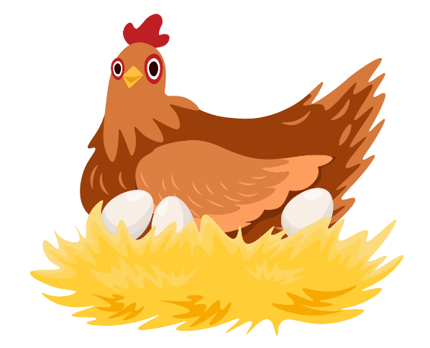
How do you choose what you eat?
Notes:
Click the green plate on and then the food image and ask….how do you choose what you eat?
Ask again for suggestions and then click through the ideas on the slide…
Friendships – do you choose something that your friend likes and you would like to try it too?
Health – you may choose something because it is good for you body…can anyone give me an example of a healthy food?
Environment – you may choose food which you know has been grown locally, for example locally grown fruit and vegetables from a farm shop. This is kind to the environment as the food has been grown naturally and not travelled far.
Animals – you choose something because it is kind to animals, for example choosing eggs from happy hens!
Feelings – you may choose some foods because you’re feeling sad or other foods when you’re feeling happy, excited, calm, good)
The smell of food – you may choose food because it smells really good!

Slide 4
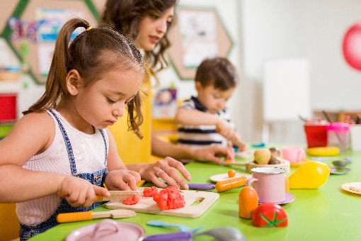
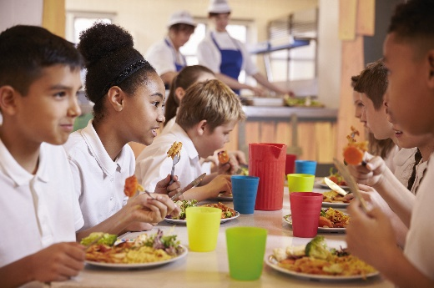
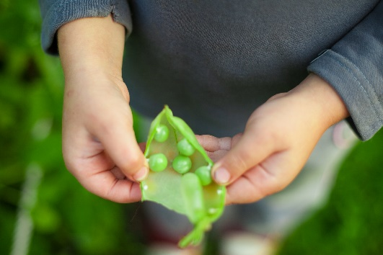
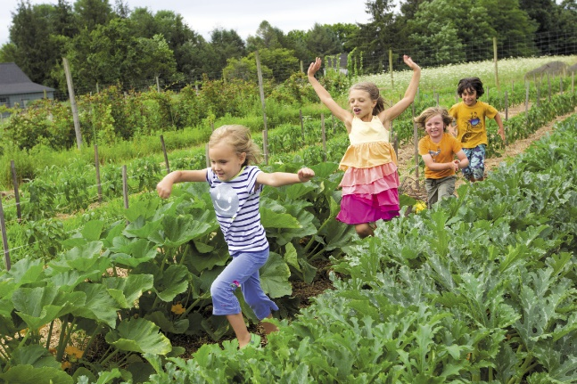
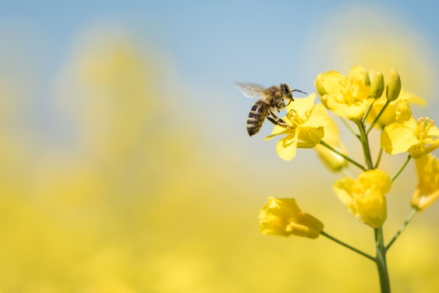
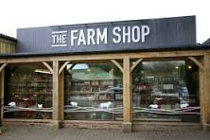
What do you think makes meals…
Good for us?
Good for nature and our environment?
Notes:
What do you think makes meals…
Good for us?....by being part of and enjoying the whole process
- Enjoy and learning about growing
- Enjoy and learn to cook from scratch using fresh ingredients that we’ve grown
- Enjoy eating together, nutritious, healthy and tasty food!
Good for nature and our environment?...by
- Planting trees, hedgerows, wildflowers to encourage biodiversity…and happy bees!
- shopping locally and growing locally – seasonal fruit and vegetables, low food miles

Slide 5
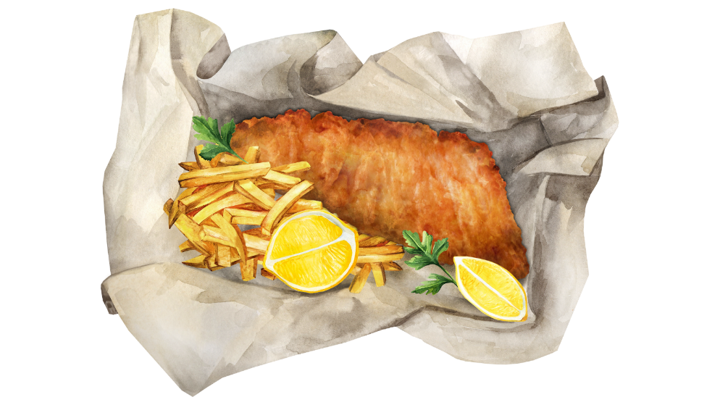
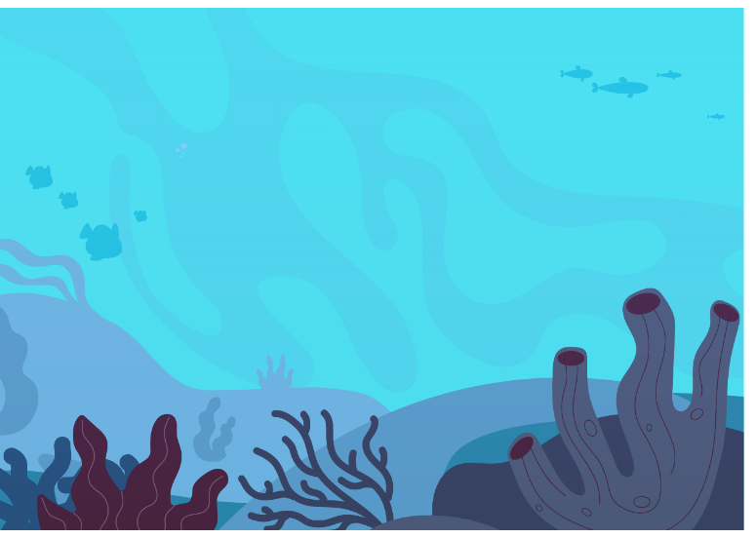
What do you think sustainable food means?
Notes:
A food being sustainable means that it can be used to feed us again and again without running out or damaging the planet.
We need to take greater care with our food choices because nothing has an endless supply. For example, if we always fish in the same areas of our planet’s oceans, the fish population won’t be able to breed and grow again, and the fish supply in that area will eventually run out.

Slide 6
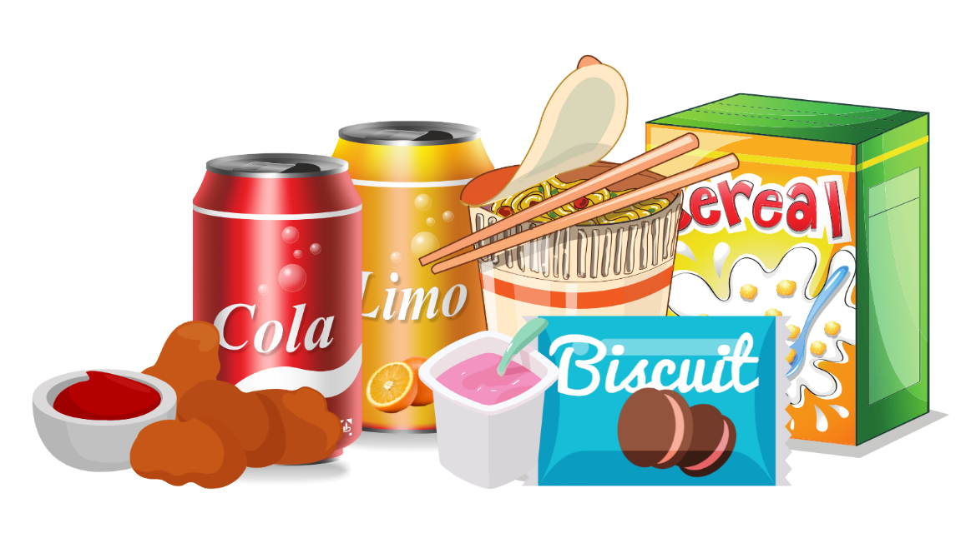
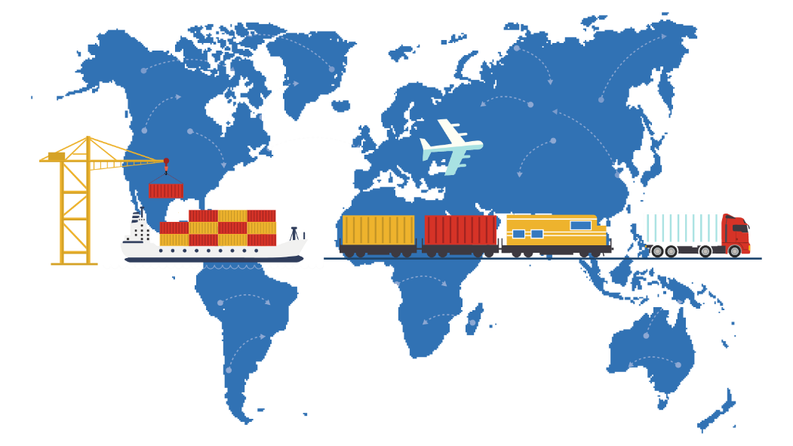
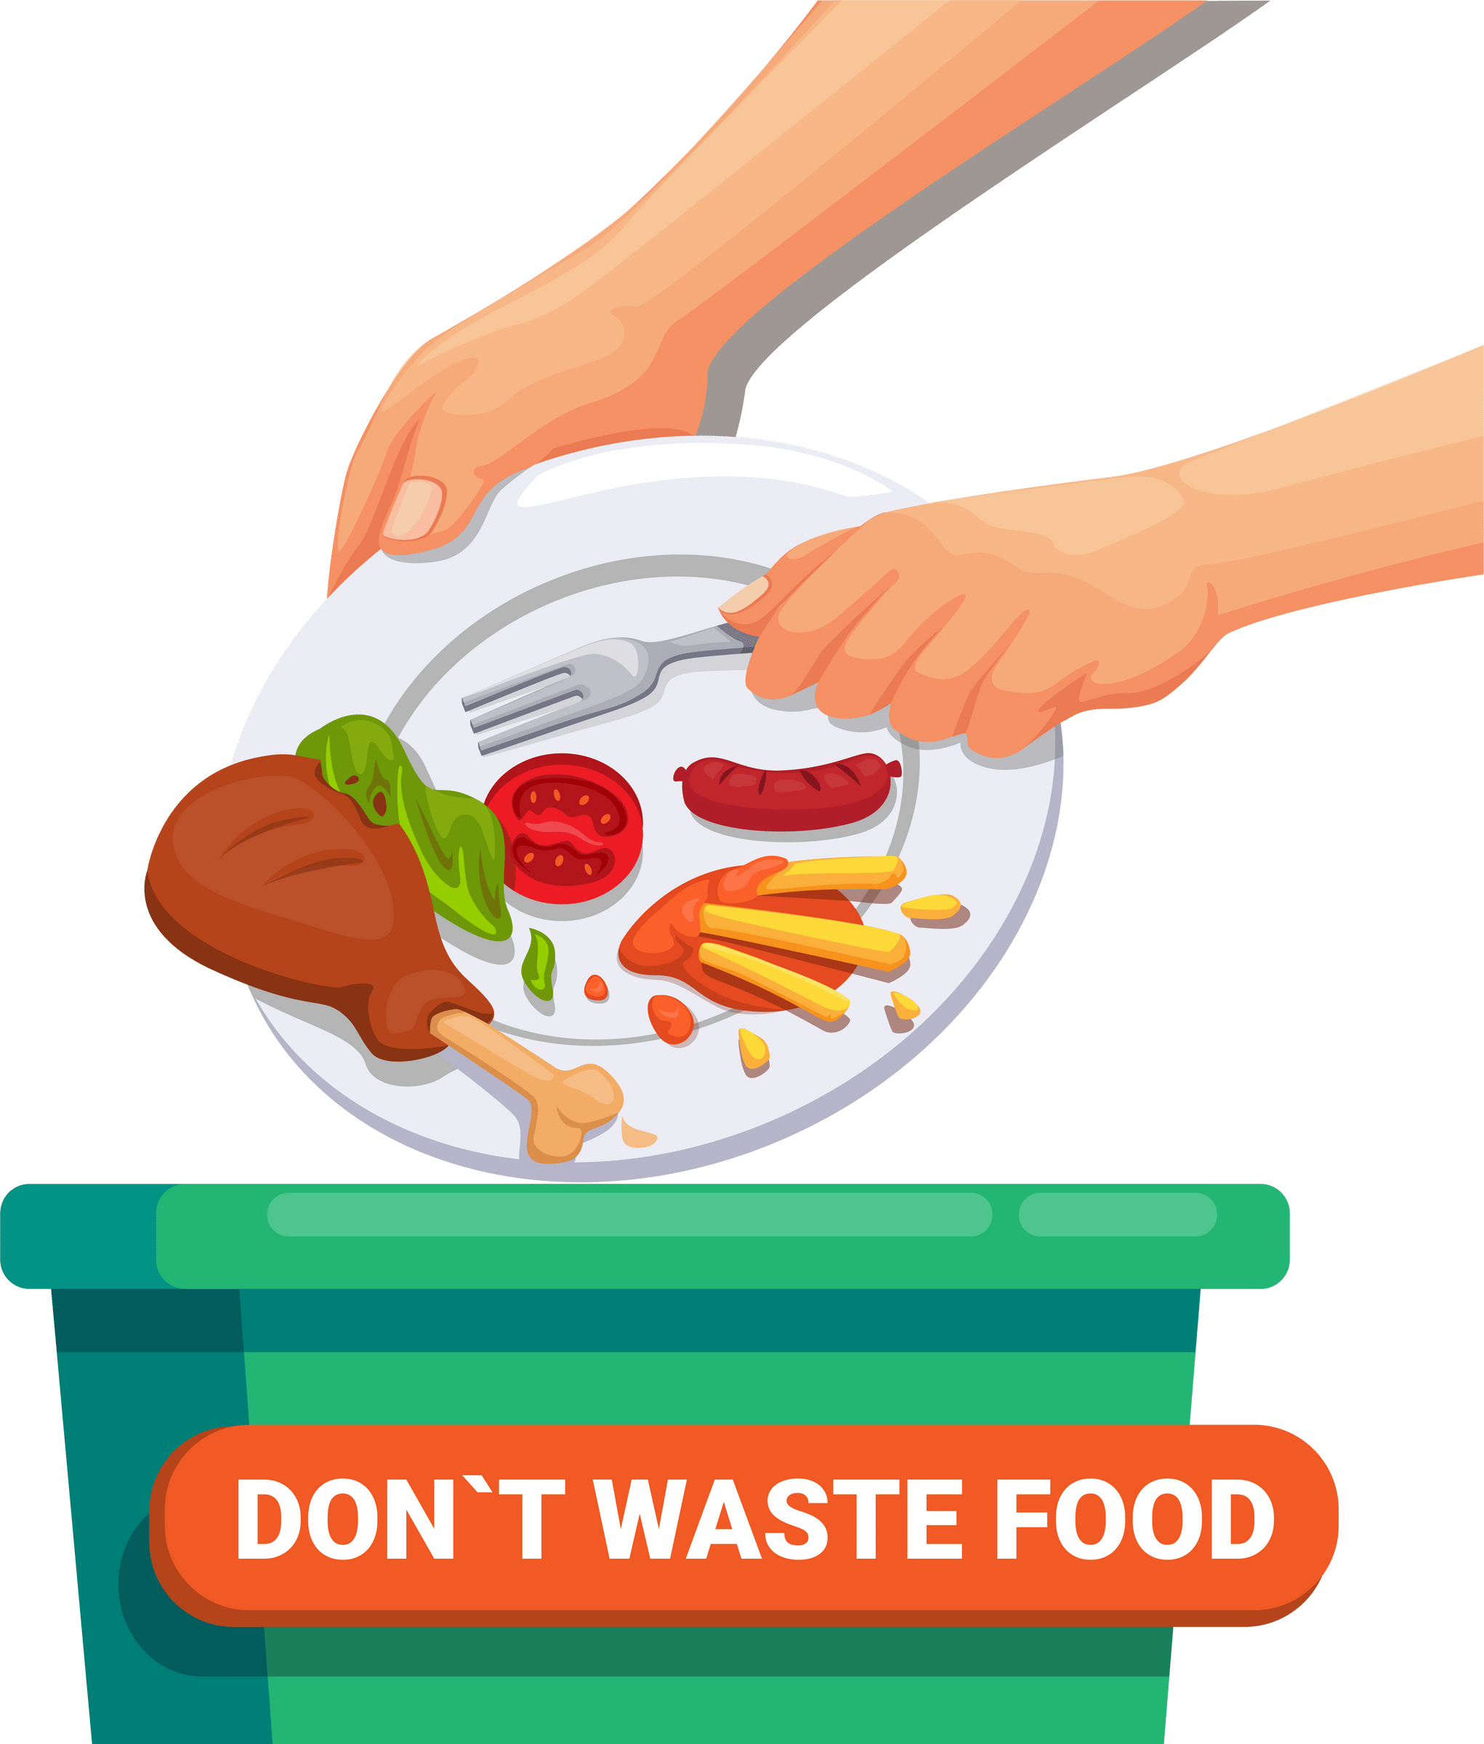
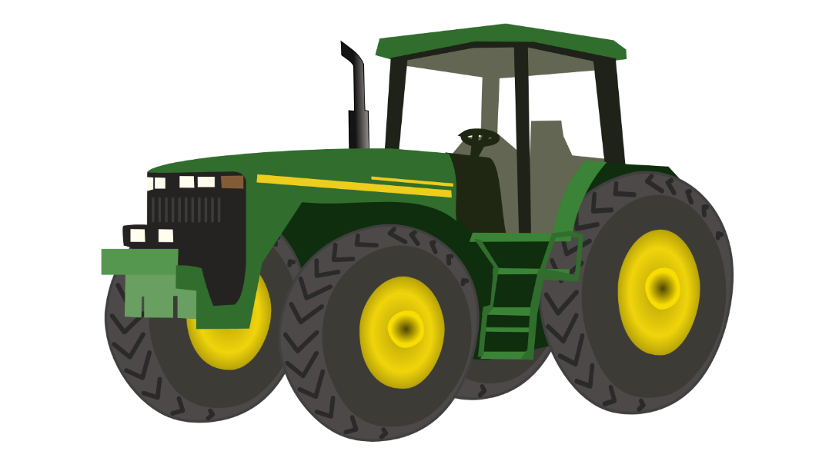
What is the importance of sustainable food?
﻿
﻿
Notes:
Problems arise when we don’t look after our planet’s resources and these problems will only get worse unless we ensure there are enough resources for the future.
In order to make more sustainable food choices, we need to consider…
Food Miles
Processed Foods
Farming techniques
Food in bellies not bins

Slide 7
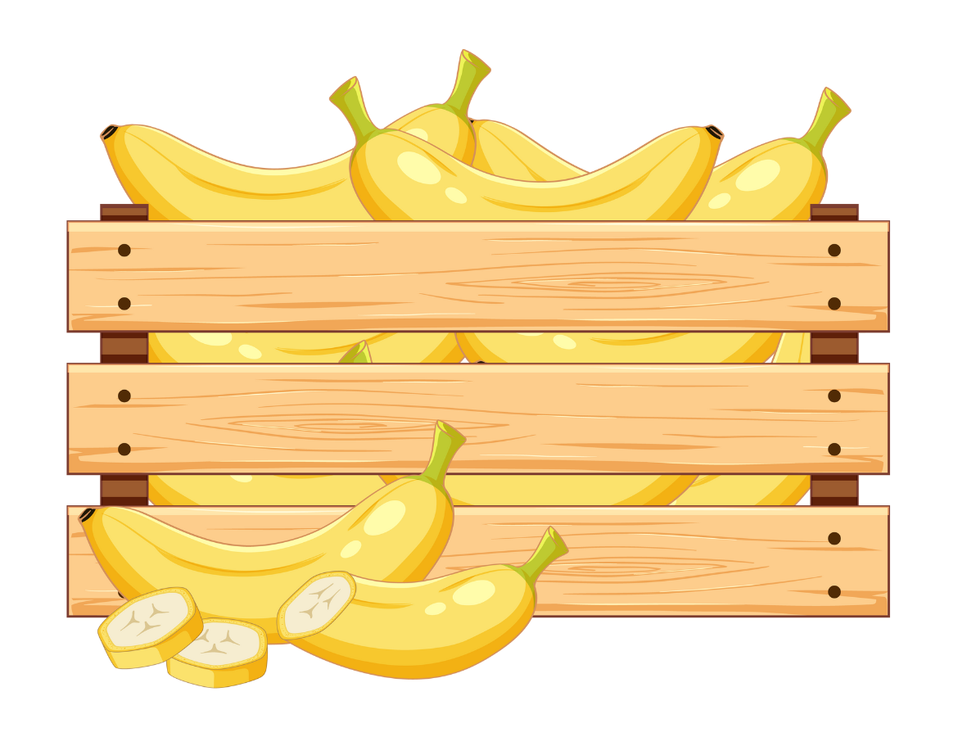
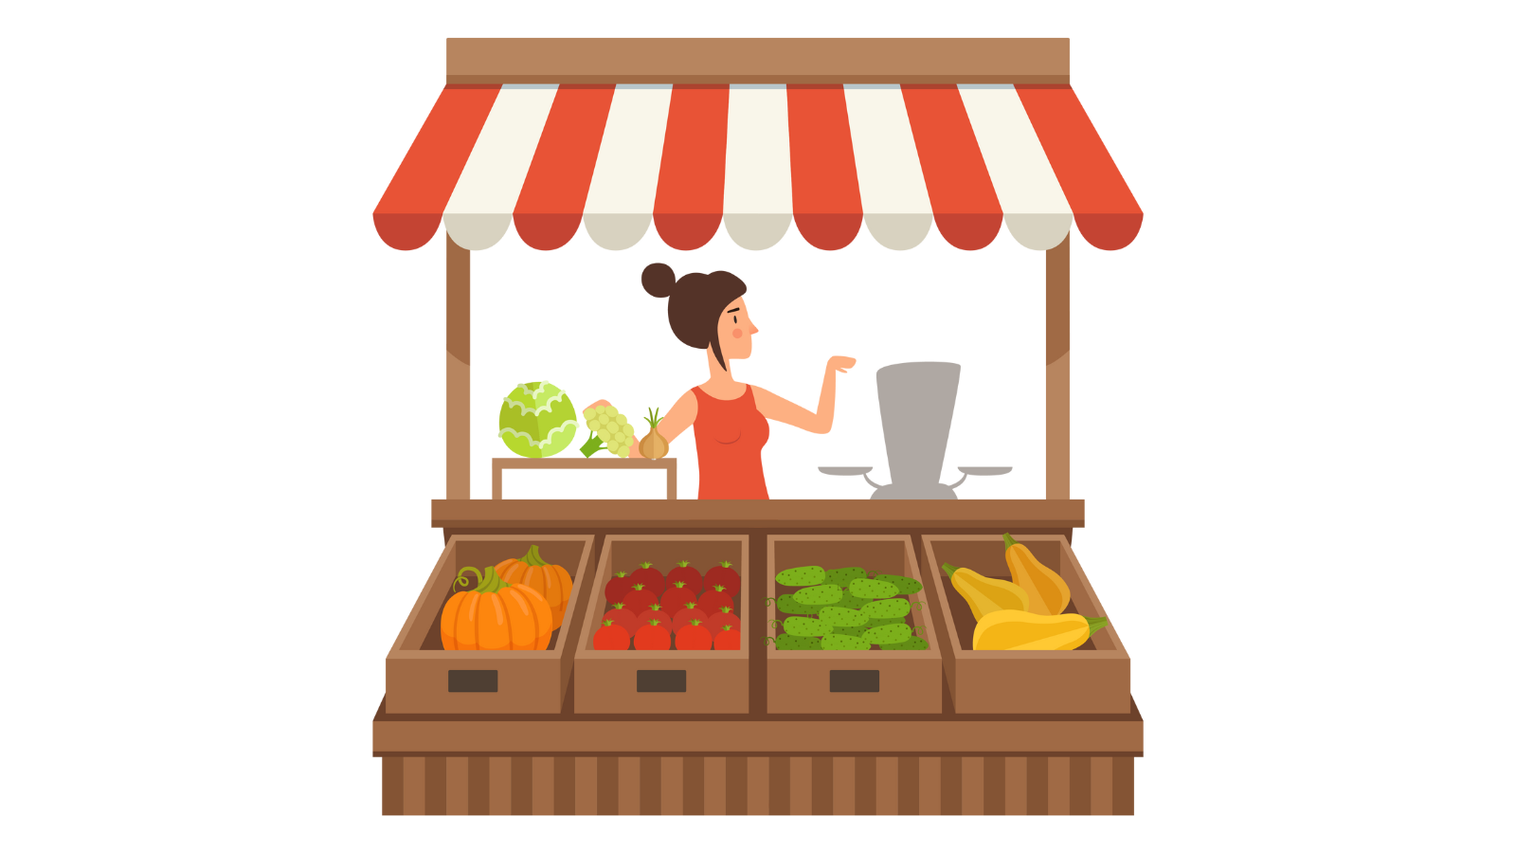
Food Miles
Notes:
Food miles measure the distance your food has travelled to get to your plate. Sometimes food may travel from the farm it is grown on in the UK to a local shop or restaurant to be sold, however other foods might travel to a factory first to be checked, sorted and packed, and then on to a supermarket or shop.
Not all the food we like to eat can be grown where we live. This depends on each country’s climate, however, almost anything can be imported (brought into our country from abroad), so we have access to food products from all over the world!
Can you think of anything we eat which can’t be grown/produced in the UK?
Food that is grown and produced locally is better for our environment because it has to travel a shorter distance and use less energy to get to us.

Slide 8
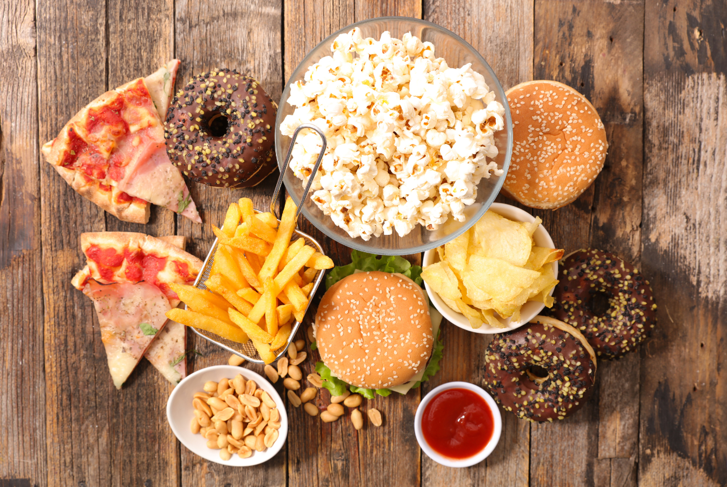
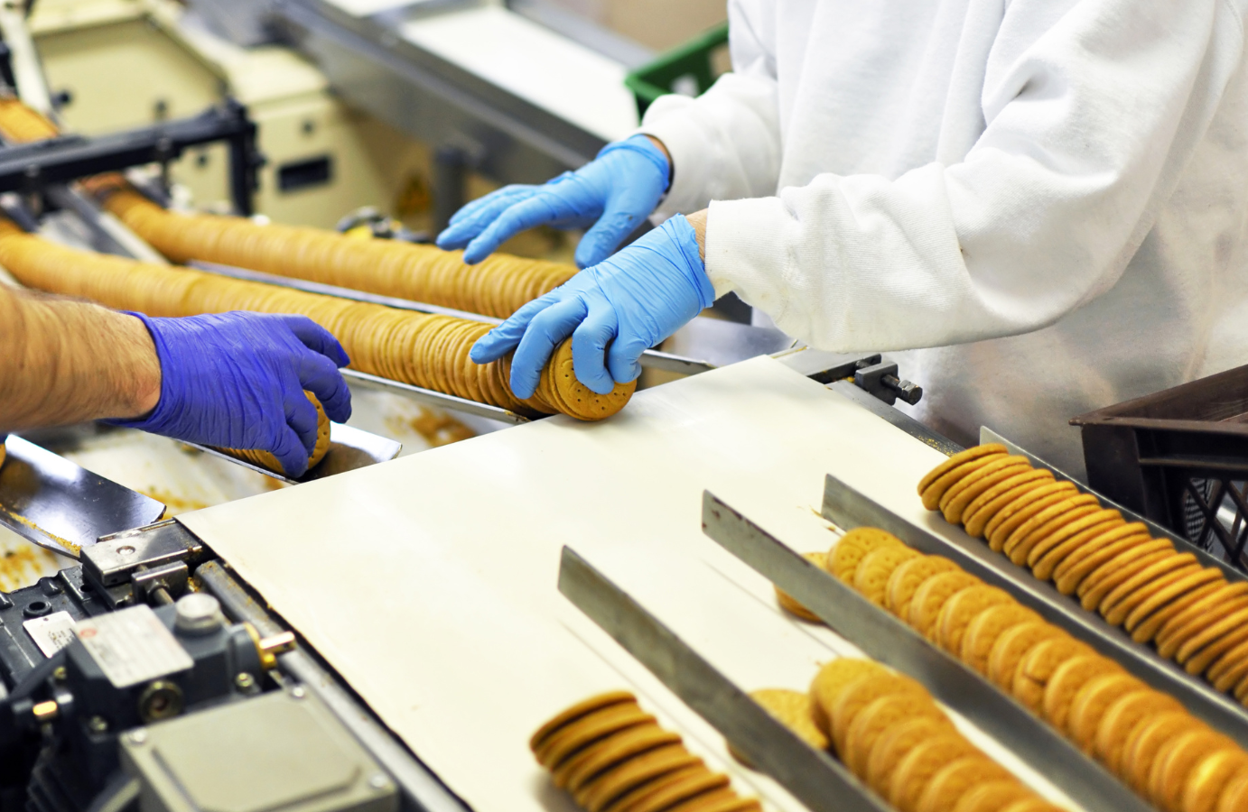
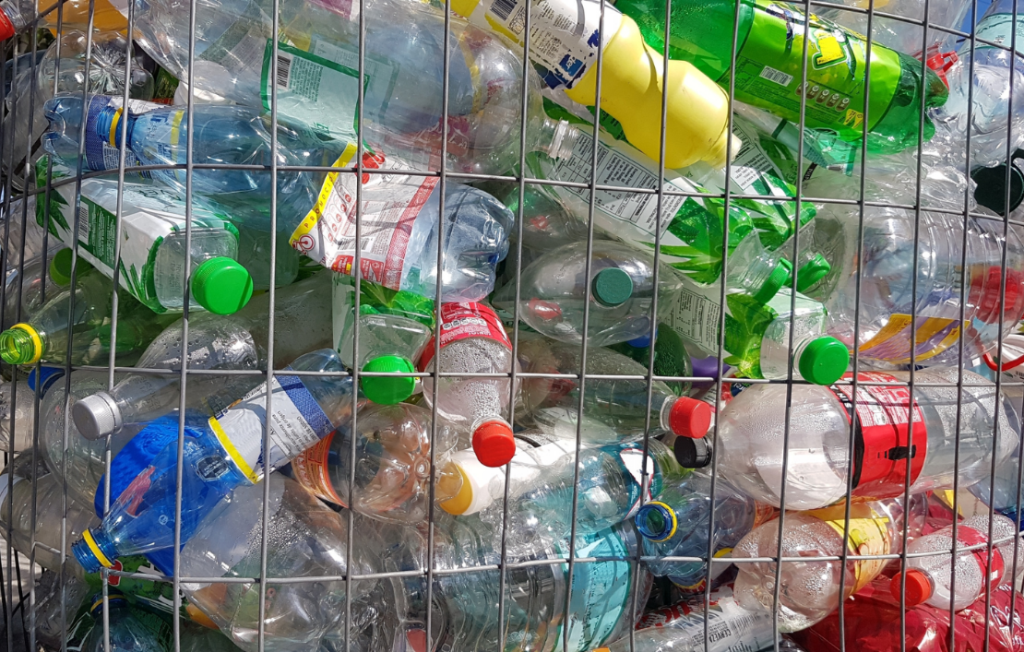
Ultra-Processed Foods
Ultra-Processed Foods
Notes:
Sadly, there are thousands of people who simply aren’t getting the nutritious food they need to thrive. Too much of the food we eat is produced in a way that is damaging the natural world and our health.
Ultra-processed foods contain a lot of different ingredients that you wouldn’t find in your kitchen. This includes things like fizzy drinks, crisps and frozen potato waffles. As well products that may make health claims on the packaging like low fat, high fibre or sugar free for example some low-fat yoghurts and breakfast cereals.
These products must be made as cheaply as possible to make more money, so growing methods involve a lot of chemicals and energy. The products themselves require more energy to produce due to higher processing, and they often come packaged in lots of plastic.
What would a more sustainable choice be?
It is our job to take care of the planet to ensure that future generations of people and animals can live and thrive on Earth.

Slide 9
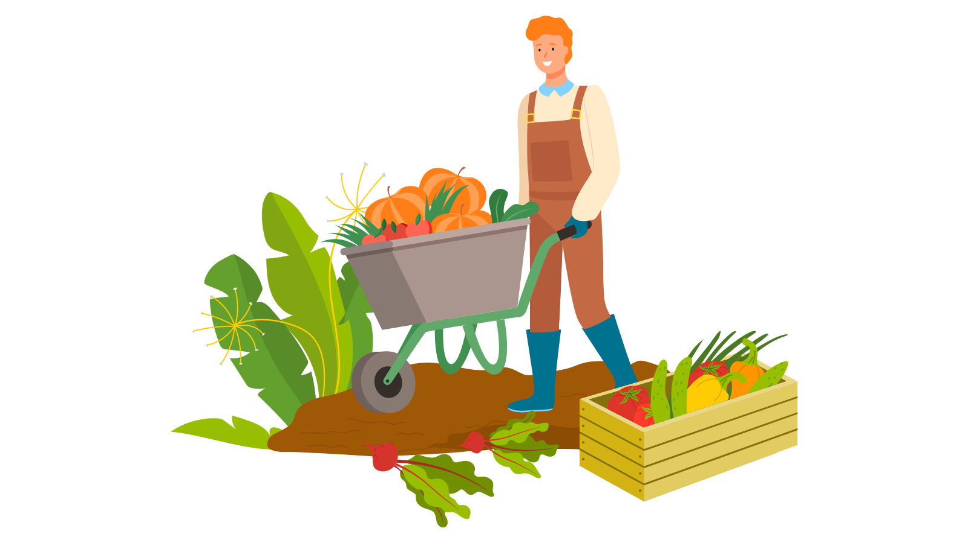
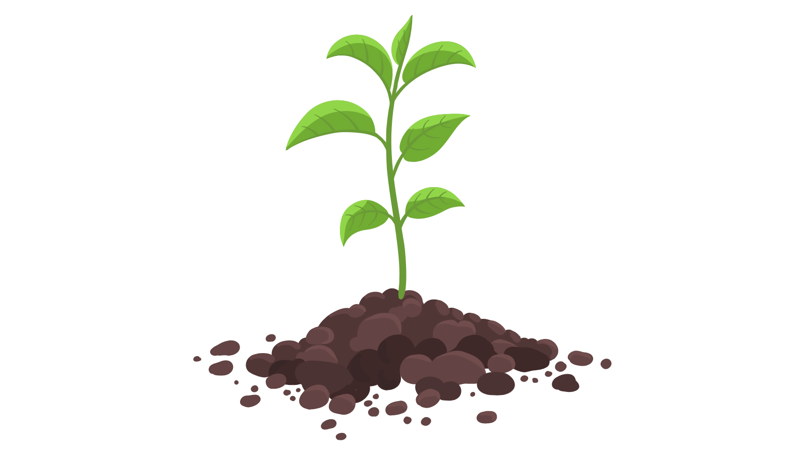
Farming techniques
Notes:
In the UK lots of people believe it is possible to produce healthy, nutritious food for all through kinder farming, such as organic – without using chemicals or killing wildlife, and while giving farm animals a good life.
Problems arise when we don’t look after the resources we have, so we need to ensure there are enough resources for future generations. The way we produce a lot of food in the UK needs to change and it all starts with our soil.
Healthy soils are full of life. They produce healthy crops that nourish people and animals. But when chemicals are used and lands are intensively farmed, soil is damaged. Keeping it healthy is essential if we are to feed a growing population and protect our environment.
.

Slide 10
Food that goes to waste
Notes:
Food waste is food that is wasted, lost or uneaten along all parts of the supply chain - from farm, to production, to supermarkets and in our homes.
Food matters when it comes to sustainability and climate as at each stage in the journey of our food draws resources from our planet and produces greenhouse gas emissions, therefore contributing to climate change. When food is wasted all the resources used along that journey is also wasted – the land, water, farmers work, fuel and more.
1.3 billion tonnes of food is wasted each year. 60% of this comes from households, so there are lots we can all do to help reduce that.
We can't always avoid food going to waste, things get bruised, and we have unavoidable waste e.g. peelings. To reduce the impact of this food we can compost it to save it going to landfill or cook it in creative ways, like making veg peeling crisps!
WRAP-Food-Surplus-and-Waste-in-the-UK-Key-Facts November-2023.pdf

Slide 11
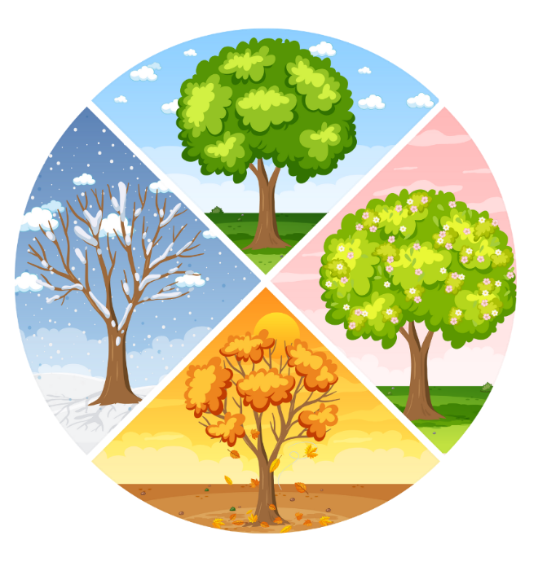
How can we be more sustainable with our food at school and at home?
Notes:
Try growing your own food. Even just some cress on a windowsill is a great way to enjoy some sustainable food.
Avoid buying and eating ultra-processed foods.
Try and find out where your food comes from, can you buy more locally rather than food that's been imported?
Eat fruits and vegetables which are in season to decrease food miles
Try to eat a variety of foods, including those which are in-season. You could also try Meat Free Mondays and try new vegetables, beans and lentils!
Collect food waste at lunch to compost the school gardens.
You can help reduce food waste by looking at fruit and veg and knowing how to know if it is still good to eat rather than using dates on the package, which aren’t always accurate.
Storing it in the right place, with the right friend. Potato and onions are not friends. Banana aren’t always the best neighbours as they make fruit ripen faster, so great if you have a hard pear but not for making fruit last.

Slide 12
Thank you!

